Slide 1
IT Project Management
IT Project Management
Ing. Petra Pavlíčková, Ph.D.
1.Lecture – Introduction and Life cycle of IT projects, Types of IT Projects
Ing. Petra Pavlíčková Ph.D.
E-mail: pavlickovap@pef.czu.cz

Slide 2
Project Management
Project management is the process and activity of planning, organizing, motivating, and controlling resources to achieve specific goals.
A project is a temporary endeavor designed to produce a unique product, service or result with a defined beginning and end (usually time-constrained, and often constrained by funding or deliverables),undertaken to meet unique goals and objectives, typically to bring about beneficial change or added value.

Slide 3
Triple constraint
The primary challenge of project management is to achieve all of the project goals:
What – the scope of the project
When – time
How many - budget

Slide 4
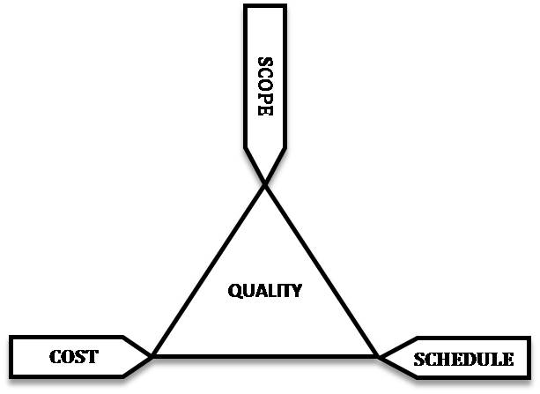
Project management triangle
Constraints like "scope," "time," and "cost„ are referred to as the project management triangle, where each side represents a constraint. One side of the triangle cannot be changed without affecting the others.

Slide 5
Project management triangle
The time constraint refers to the amount of time available to complete a project.
The cost constraint refers to the budgeted amount available for the project.
The scope constraint refers to what must be done to produce the project's end result.
These three constraints are often competing constraints: increased scope typically means increased time and increased cost, a tight time constraint could mean increased costs and reduced scope, and a tight budget could mean increased time and reduced scope.

Slide 6
Successful project
The successful project is the project that achieved the established goal:
at the scheduled time
assigned resources
without negative impacts

Slide 7
Project management
Project management includes:
Phases
Check points
Documentation

Slide 8
Project phases
A traditional phased approach identifies a sequence of steps to be completed. In the "traditional approach", five developmental components of a project can be distinguished (four stages plus control):
Typical development phases of an engineering project:
initiation
planning and design
execution and construction
monitoring and controlling systems
completion

Slide 9
Systems development life-cycle
Is a term used in systems engineering, information systems and software engineering to describe a process for planning, creating, testing, and deploying an information system. The systems development life-cycle concept applies to a range of hardware and software configurations, as a system can be composed of hardware only, software only, or a combination of both.

Slide 10
Systems development life-cycle (SDLC)
The system development life cycle framework provides a sequence of activities for system designers and developers to follow. It consists of a set of steps or phases in which each phase of the SDLC uses the results of the previous one.
Preliminary analysis
Systems analysis, requirements definition
Systems design
Development
Integration and testing
Acceptance, installation, deployment
Maintenance
Evaluation
Disposal

Slide 11
Systems development life-cycle (SDLC)
Preliminary analysis: The objective of phase 1 is to conduct a preliminary analysis, propose alternative solutions, describe costs and benefits and submit a preliminary plan with recommendations.
Conduct the preliminary analysis: in this step, you need to find out the organization's objectives and the nature and scope of the problem under study. Even if a problem refers only to a small segment of the organization itself then you need to find out what the objectives of the organization itself are. Then you need to see how the problem being studied fits in with them.
Alternate proposals may come from interviewing employees, clients, suppliers, and/or consultants. You can also study what competitors are doing. With this data, you will have three choices: leave the system as is, improve it, or develop a new system.Describe the costs and benefits.

Slide 12
Systems development life-cycle (SDLC)
Systems analysis, requirements definition: Defines project goals into defined functions and operation of the intended application. Analyzes end-user information needs.
Systems design: Describes desired features and operations in detail, including screen layouts, business rules, process diagram, pseudocode and other documentation.

Slide 13
Systems development life-cycle (SDLC)
Development: The real code is written here.
Integration and testing: Brings all the pieces together into a special testing environment, then checks for errors, bugs and interoperability.
Acceptance, installation, deployment: The final stage of initial development, where the software is put into production and runs actual business.
Maintenance: During the maintenance stage of the SDLC, the system is assessed to ensure it does not become obsolete. This is also where changes are made to initial software. It involves continuous evaluation of the system in terms of its performance.

Slide 14
Systems development life-cycle (SDLC)
Evaluation: Some companies do not view this as an official stage of the SDLC, but is it an important part of the life cycle. Evaluation step is an extension of the Maintenance stage. This is where the system that was developed, as well as the entire process, is evaluated.
Some of the questions that need to be answered include: does the newly implemented system meet the initial business requirements and objectives? Is the system reliable and fault-tolerant? Does the system function according to the approved functional requirements. If there are any aspects of the entire process, or certain stages, that management is not satisfied with, this is the time to improve.

Slide 15
Systems development life-cycle (SDLC)
Disposal: In this phase, plans are developed for discarding system information, hardware and software in making the transition to a new system. The purpose here is to properly move, archive, discard or destroy information, hardware and software that is being replaced, in a matter that prevents any possibility of unauthorized disclosure of sensitive data. The disposal activities ensure proper migration to a new system.

Slide 16
Systems development life-cycle (SDLC)
System investigation
The system investigation stage addresses the needs or opportunities that can be achieved by a sponsor or IT proposal. During this step, we must consider all current priorities that would be affected and how they should be handled. Before any system planning is done, a feasibility study should be conducted to determine if creating a new or improved system is a viable solution. This will help to determine the costs, benefits, resource requirements, and specific user needs required for completion.

Slide 17
Systems development life-cycle (SDLC) - System investigation
Following are different components of the feasibility study:
Operational feasibility - Operational feasibility is a measure of how well a proposed system solves the problems, and takes advantage of the opportunities identified during scope definition and how it satisfies the requirements identified in the requirements analysis phase of system development
Economic feasibility - The purpose of the economic feasibility assessment is to determine the positive economic benefits to the organization that the proposed system will provide. It includes quantification and identification of all the benefits expected. This assessment typically involves a cost/ benefits analysis
Technical feasibility - The technical feasibility assessment is focused on gaining an understanding of the present technical resources of the organization and their applicability to the expected needs of the proposed system. It is an evaluation of the hardware and software and how it meets the need of the proposed system
Human factors feasibility
Legal/Political feasibility - Determines whether the proposed system conflicts with legal requirements, e.g. a data processing system must comply with the local Data Protection Acts.

Slide 18
Systems development life-cycle (SDLC) - System analysis
The goal of system analysis is to determine where the problem is in an attempt to fix the system. This step involves breaking down the system in different pieces to analyze the situation, analyzing project goals, breaking down what needs to be created and attempting to engage users so that definite requirements can be defined.

Slide 19
Systems development life-cycle (SDLC) -Design
In systems design the design functions and operations are described in detail, including screen layouts, business rules, process diagrams and other documentation. The output of this stage will describe the new system as a collection of modules or subsystems.
The design stage takes as its initial input the requirements identified in the approved requirements document. For each requirement, a set of one or more design elements will be produced as a result of interviews, workshops, and/or prototype efforts.
Design elements describe the desired system features in detail, and generally include functional hierarchy diagrams, screen layout diagrams, tables of business rules, business process diagrams, pseudo-code, and a complete entity-relationship diagram with a full data dictionary. These design elements are intended to describe the system in sufficient detail, such that skilled developers and engineers may develop and deliver the system with minimal additional input design.

Slide 20
Work breakdown structured (WBS)
The upper section of the work breakdown structure (WBS) should identify the major phases and milestones of the project in a summary fashion. In addition, the upper section should provide an overview of the full scope and timeline of the project and will be part of the initial project description effort leading to project approval.
The middle section of the WBS is based on the seven systems development life cycle phases as a guide for WBS task development. The WBS elements should consist of milestones and "tasks" as opposed to "activities" and have a definitive period (usually two weeks or more). Each task must have a measurable output (e.x. document, decision, or analysis).
A WBS task may rely on one or more activities (e.g. software engineering, systems engineering) and may require close coordination with other tasks, either internal or external to the project.

Slide 21
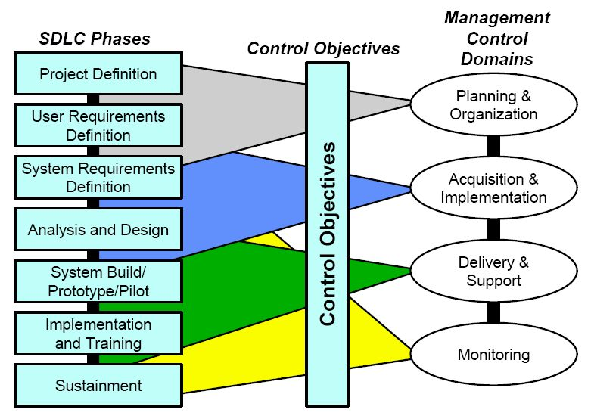
Work breakdown structured (WBS)

Slide 22
Project - stakeholders
Stakeholders: | Stakeholder's concerns:^{[2]}
Government | taxation, VAT, legislation, employment, truthful reporting, diversity, legalities, externalities.
Employees | rates of pay, job security, compensation, respect, truthful communication.
Customers | value, quality, customer care, ethical products.
Suppliers | providers of products and services used in the end product for the customer, equitable business opportunities.
Creditors | credit score, new contracts, liquidity.
Community | jobs, involvement, environmental protection, shares, truthful communication.
Trade Unions | quality, worker protection, jobs.
Owner(s) | profitability, longevity, market share, market standing, succession planning, raising capital, growth, social goals.
Investors | return on investment, income.

Slide 23
Objective of the project plan
The objective of a project plan is to define the approach to be used by the Project team to deliver the intended project management scope of the project.
At a minimum, a project plan answers basic questions about the project:
Why? - What is the problem or value proposition addressed by the project? Why is it being sponsored?
What? - What is the work that will be performed on the project? What are the major products/deliverables?
Who? - Who will be involved and what will be their responsibilities within the project? How will they be organized?
When? - What is the project timeline and when will particularly meaningful points, referred to as milestones, be complete?

Slide 24
SMART goal
SMART:
S – specific – we need to know what
M – measurable
A – agreed
R – realistic
T – timed – define time checkpoints
Sometime also i (integrated) – integrated to the organization

Slide 25
List of references:
- Wikipedia (Project management)

